Slide 1

Intelligent AI-Powered HR Recruitment System
Final Year Project – Proposal Presentation
By
Zunaira Akbar NUM-BSCS-2022-34
Umair Ahmad NUM-BSCS-2022-36
Supervisor: Mr. Abdul Rafay
Co-Supervisor: Ms. Asiya Batool
Industrial Partner: Techinn.io
Notes:
Good afternoon, respected panel.
We are presenting our Final Year Project Proposal titled “Intelligent AI-Powered HR Recruitment System.”
I am Zunaira Akbar, and my teammate is Umair Ahmad.
Our supervisor is Sir Abdul Rafay, with Miss Asiya Batool as our co-supervisor, and our industrial partner is Techinn.io.

Slide 2
Outline
Introduction
Literature Review / Related Existing Products
Problem Statement and Objectives
Proposed Design Methodology
Hardware / Software Tools
Proposed Work Plan (Gantt Chart)
Thank You / Q&A
Notes:
Here is the outline of our presentation.
We’ll begin with an introduction, then move to the problem statement and objectives, followed by the proposed design and methodology.
After that, we’ll discuss the tools and technologies, our work plan, and finally conclude with a Q&A session.

Slide 3
Introduction
Recruitment today is complex, time-consuming, and prone to bias.
HR teams manually screen thousands of resumes stored in HRMS.
These manual processes delay hiring and overlook strong candidates.
AI-powered systems can automate screening, enhance decision-making, and improve candidate experience.
Our project aims to develop an AI-based recruitment system integrating NLP, Machine Learning, and workflow automation.
Notes:
In today’s hiring process, HR teams handle thousands of resumes manually.
This process is slow, biased, and often causes strong candidates to be overlooked.
Our goal is to solve this problem using Artificial Intelligence, to automate screening, improve decision-making, and enhance candidate experience.
We plan to develop an AI-based recruitment system that uses NLP, machine learning, and workflow automation to make hiring faster and fairer.

Slide 4
Problem Statement
Traditional HR recruitment is inefficient, biased, and heavily dependent on manual tasks from resume screening to offer management causing delays and inconsistent hiring decisions.
Objectives:
Automate job posting, screening, and shortlisting.
Apply NLP & ML to parse and match resumes with job description and do semantic scoring (technical and soft skills scoring).
Integrate customized chatbot API for candidate interaction.
Analyze soft skills using video/audio responses.
Enable HR dashboard for automated decisioning and offer management.
Notes:
Traditional recruitment is inefficient and highly manual.
It involves repetitive tasks like resume screening, communication, and offer management.
This leads to delays and inconsistent hiring decisions.
Our objectives are:
Automate job posting, screening, and shortlisting.
Use NLP and ML to match resumes with job descriptions.
Integrate a chatbot for candidate communication.
Analyze soft skills through AI-based video or audio analysis.
Provide an HR dashboard for automated decision-making and offer management.

Slide 5
Literature Review
Background: AI in Recruitment
Early AI recruitment tools used keyword-based systems → lacked semantic understanding.
With NLP & Deep Learning (BERT, Sentence-BERT), recruitment evolved toward semantic matching.
Resume parsing: Extracts skills, experience, and education from unstructured CVs.
Semantic similarity models: Match resumes with job descriptions more accurately.
AI-based assessment tools: Analyze communication, facial expressions, and tone.
Platforms like Resume Matcher and AI-based ATS prove strong potential but lack end-to-end workflow automation.
Our system extends beyond matching — it automates the entire recruitment lifecycle.
Notes:
Early recruitment systems only used keyword matching, which ignored the meaning behind text.
With NLP and deep learning models like BERT and Sentence-BERT, systems can now understand context and match resumes more accurately.
Existing tools such as Resume Matcher or AI-based ATS show good results, but they don’t automate the full recruitment cycle.
Our system aims to provide complete end-to-end automation.

Slide 6
Related Existing Products
Tool/Product | CV Parsing | Semantic Scoring | Chatbot API | Soft Skill Analysis (AI Video Interview) | Interview Automation | Offer Management
HireVue | ✗ | ✗ | ✓ | ✓ | ✗ | ✓
Eightfold.ai | ✓ | ✓ | ✗ | ✗ | ✗ | ✗
Zoho Recruit | ✓ | ✗ | ✓ | ✗ | ✓ | ✓
Our Project | ✓ | ✓ | ✓ | ✓ | ✓ | ✓

Slide 7
Proposed Design Methodology
High-Level Architecture Overview
Core Flow: HRMS CV Database → CV Analyzer → Semantic Scoring (Technical + Soft Skill Scoring) → Chatbot Interaction → Online Interview → AI Video/Audio Analysis (Soft Skill Scoring) → Physical Interview → Offer/Apology Automation
Key Components
CV Analyzer: Uses NLP (BERT/Sentence-BERT) to extract and parse resume data automatically.
Technical and Soft Skill Scoring: Calculates fit score based on skills, experience, and education.
Soft Skill Scoring: Evaluates communication, clarity, and confidence from video/audio responses.
Chatbot API: Handles FAQs, status updates, and HR queries.
Automated Email System: Sends interview invitations and rejection messages.
AI Interview Module: Flags low-confidence or negative responses for HR review.
Offer Management: Automates physical interview scheduling and offer/rejection letters.
Innovation: End-to-end automation of the recruitment cycle combining NLP, AI-based analysis, and chatbot-driven communication — a complete closed-loop workflow missing in current systems.
Notes:
Our system starts with the HRMS CV database.
CVs are analyzed using NLP to extract and score candidate information.
Then the system evaluates both technical and soft skills.
A chatbot handles candidate queries and interview scheduling.
Finally, the system automates interview invitations, offer letters, and rejections.
The innovation here is full automation of the recruitment cycle using AI and chatbot-driven communication.

Slide 8
Proposed Design Methodology
Component-Level Design
CV Analyzer: Extracts key data (skills, education, experience) using NLP and calculates similarity between CV and job description.→ Candidates with ≥70% match move forward.
Scoring Modules: Technical and Soft Skills Scoring: Uses text similarity and weighted parameters.
Soft Skill Scoring: Evaluates tone, clarity, and expression via OpenCV + Hugging Face.
AI Interview Module: Detects emotional stability, confidence, and attentiveness; HR reviews flagged segments.
Chatbot Module: Built with Rasa/Dialogflow to handle FAQs, updates, and candidate communication.
Interview Automation: Auto-schedules interviews, sends invites and feedback emails.
Dashboard: Developed in React for HR to view rankings, filter results, and visualize analytics.
Notes:
Each component has a specific role:
The CV Analyzer uses BERT to extract skills and experience.
Technical and Soft Skills Scoring measures how well a candidate matches job needs.
Soft Skill Scoring uses video or audio responses to check confidence and communication.
The Chatbot answers questions and gives updates.
The Interview Automation will automatically ..
The Dashboard helps HR visualize rankings and make final decisions.

Slide 9
Proposed Design Methodology
SRS Highlights:
Functional Requirements:
Auto-fetch and parse CVs on job posting.
Automatically rank, shortlist, and send interview/offer/rejection emails.
Provide explainable AI results (e.g., “Matched due to 5+ years of Python experience”).
Non-Functional Requirements:
Scalable: Handle up to 10,000 CVs/day.
Secure: GDPR-compliant data storage and handling.
Accurate: >85% match and soft-skill classification accuracy.
Ethical Considerations:
Regular bias audits to ensure fairness.
Transparent scoring — no black-box decisions.
Notes:
Our system has both functional and non-functional goals.
Functionally, it automatically fetches CVs, ranks candidates, and sends interview or offer emails.
Non-functionally, it must handle up to 10,000 CVs per day, maintain data security, and achieve more than 85% accuracy.
We also focus on ethics — ensuring fairness and transparency in AI decisions.

Slide 10
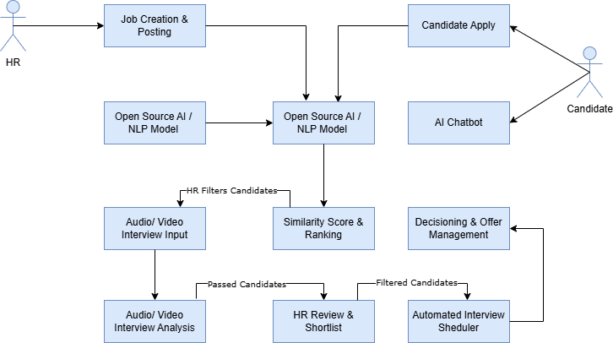
Workflow Diagram

Slide 11
Hardware/Software Tools
Tools Selection Rationale
Software:
  Python 3.12 → Core language; versatile for AI & ML workflows.
  NLP: Hugging Face Transformers (BERT / Sentence-BERT) → Pre-trained, open-source, efficient for semantic matching; achieves 90%+ accuracy on benchmarks.
  CV: OpenCV / MediaPipe → Real-time facial and speech analysis; lightweight for prototype integration.
  Chatbot Module: Built with Rasa/Dialogflow to handle FAQs, updates, and candidate communication.
  Frontend: React.js → Interactive, responsive dashboard; easy to scale and maintain.
  Backend: Flask / Django → Handles API integration and secure communication with HRMS.
Hardware: Standard Laptop (Intel i7, 16 GB RAM, optional GPU for training).Cloud Deployment (AWS / GCP) for scalability and storage.
Why These? All open-source → minimizes cost. Proven reliability in AI-based recruitment research (BERT used in ~70% of modern AI HR tools). Scalable, cross-platform, and cost-effective for both development and deployment phases.
Notes:
We’ll use Python for core development and Flask or Django for the backend.
For NLP, we’ll use BERT from Hugging Face.
OpenCV and MediaPipe will help analyze videos and speech.
React.js will be used for the frontend dashboard, and the system will be deployed on cloud platforms like AWS or GCP.
All tools are open-source and cost-effective, making our system scalable and affordable.

Slide 12
Proposed Work Plan
Semester-Wise Breakdown (Session 2022-2026; Focus on FYP Phases)
Modules/Tasks: Research & Lit Review; CV Analyzer Dev; Chatbot API integration, Interview Module integration; Interview Automation; Dashboard & Testing; Documentation.
Timeline: 6 months total (Oct 2025 - June 2026).
Team Workload: Umair Ahmad (backend/AI),
Zunaira Akbar (frontend/integration).
Notes:
Our total project duration is six months — from October 2025 to June 2026.
Umair will focus mainly on backend and AI modules, and I, Zunaira, will work on the frontend and integration.
We’ll start with research, then move to development, integration, testing, and finally documentation and presentation

Slide 13
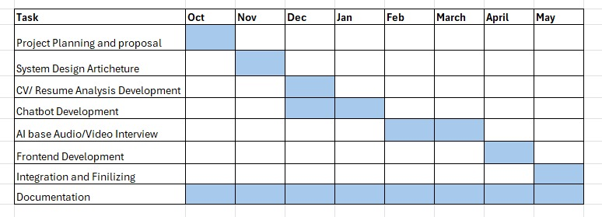
Proposed Work Plan

Slide 14
Thank You
Notes:
That’s all from our side.
Thank you for listening patiently.
We’ll now be happy to answer any questions.

